Slide 1

My objective: a quick entry with minimum effort (<6 hours)
Used:
Kaggle kernels for data preparation and feature engineering
Mljar.com for training, tuning and prediction

Slide 2

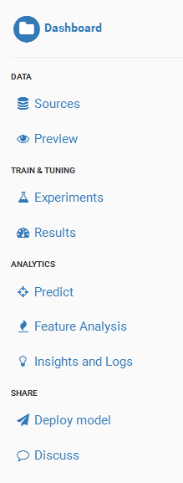
Mljar.com Workflow…
Load Train and Test Data
Models
Download Prediction File

Slide 3
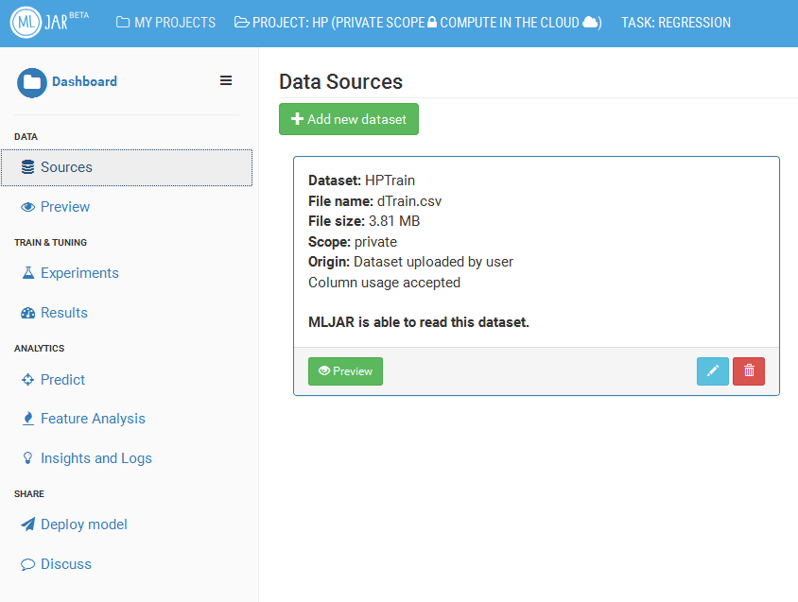
Load data…
Source: Kaggle

Slide 4
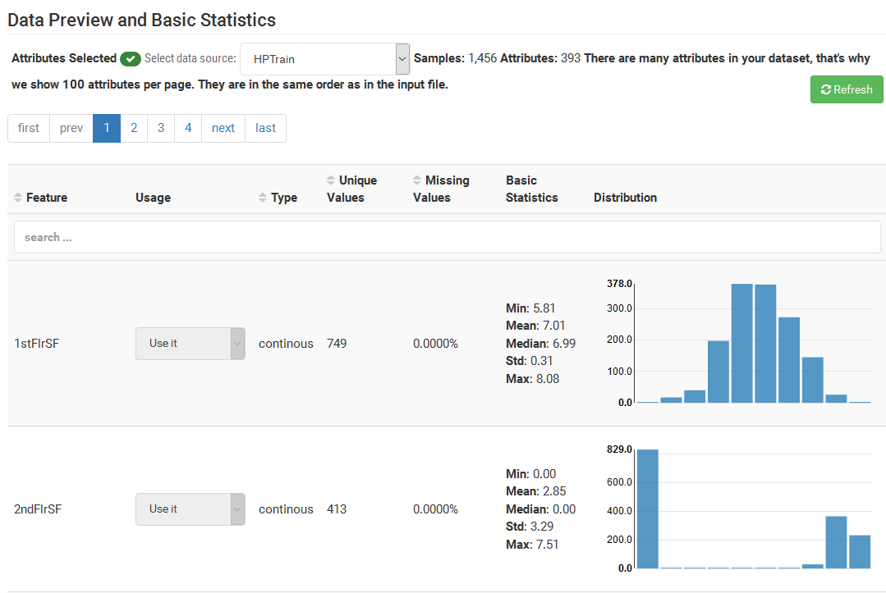

Slide 5
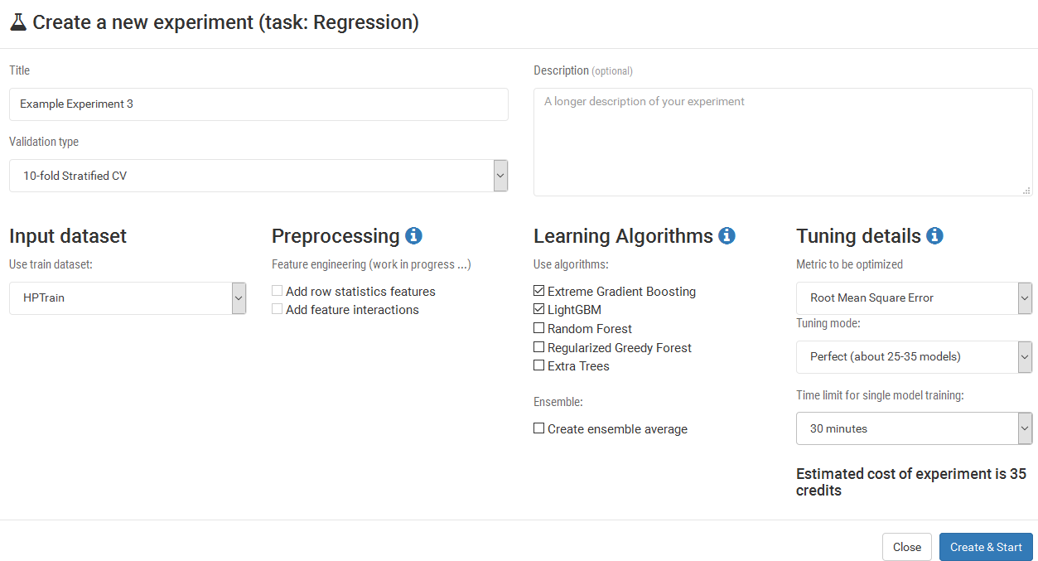
Conduct Experiments…

Slide 6
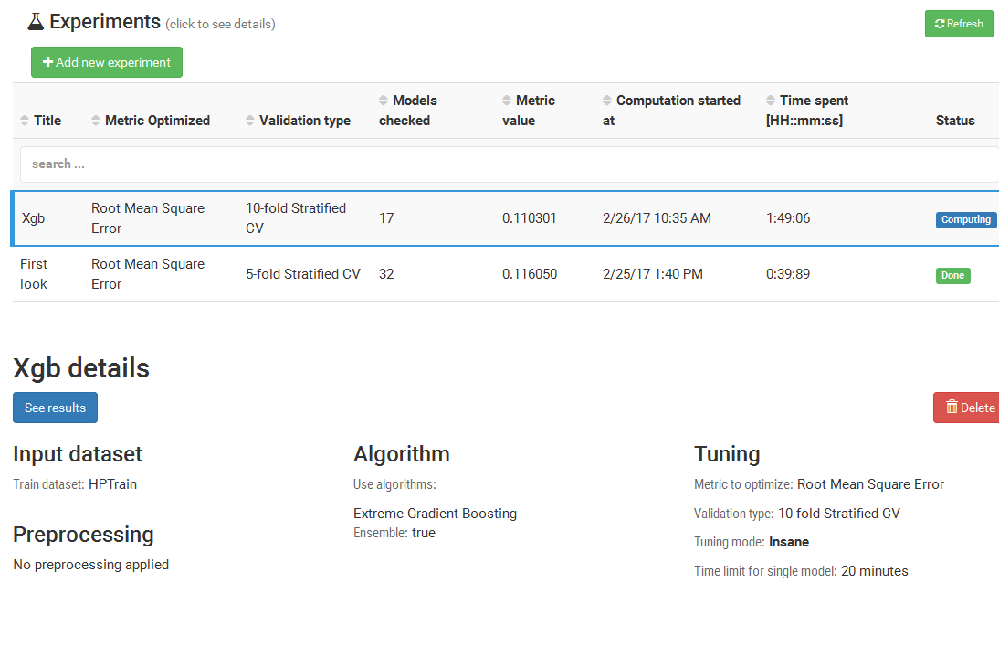
Source: Kaggle

Slide 7
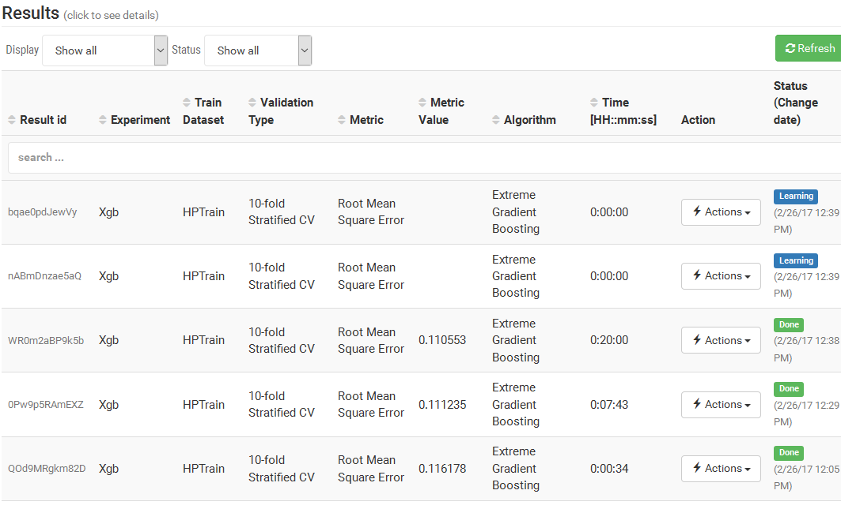
View Results…

Slide 8
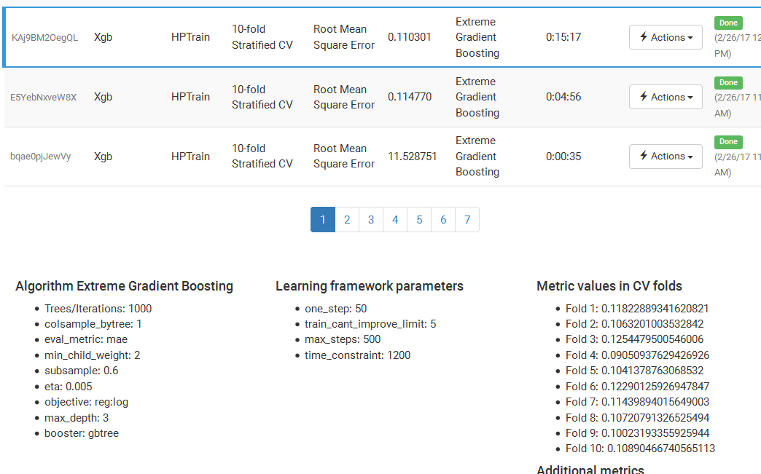
View Results (continued)… View each model’s parameters
Source: Kaggle

Slide 9
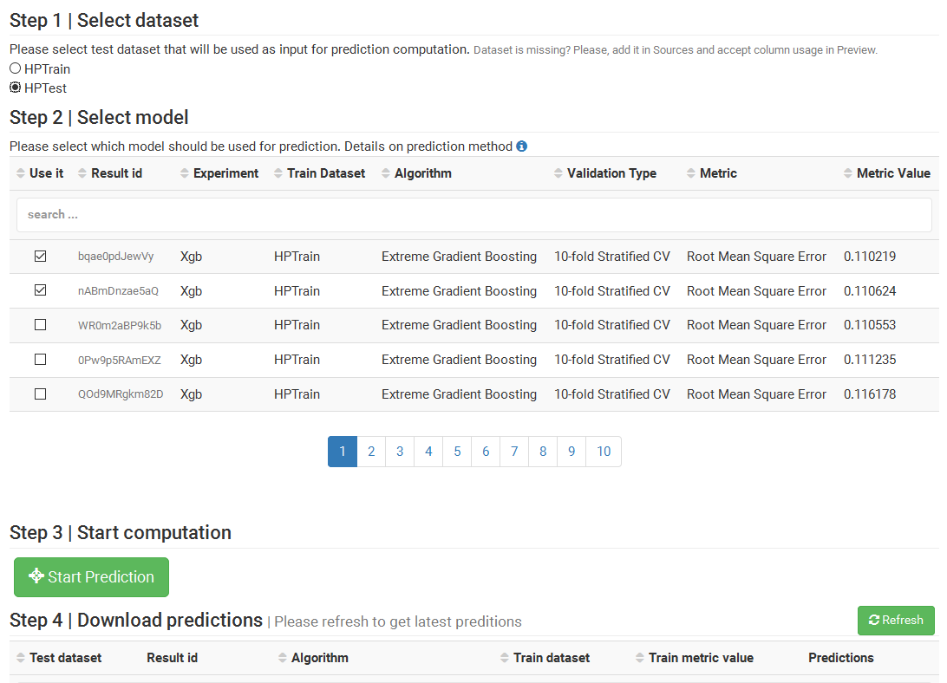
Create Prediction File and Download…
Source: Kaggle

Slide 10
Submission Scores…
Submission | Score | LB Place of 4643 | Top %
Mljar Ensemble (5 algos, 5 models each) | 0.17601 | 3801 | 82%
Xgboost best single model – 0.116050 | 0.12158 | 1391 | 30%
Eight (4 x xgboost, with best of other 4 models) | 0.12553 | No Imprv | -
Six (best of xgboost x 4, best LightGBM, best RGF) | 0.12116 | 1346 | 29%
Xgboost best single model - 0.110219 | 0.12402 | No Imprv | -
Xgboost (best 3 xgb with best Light GBM, best RGF) | 0.12144 | No Imprv | -
5 Fold CV
10 Fold CV
And more time and models

